Slide 1



Email id, contact no.:
Home About us Service Product F&Q Contact us
Automotive Fuel Injector – 1 Car image + 6 injector images
Marine Fuel Injector – 2 boat images + injector
Motor Bike Fuel Injector – 1 Bike Image + Injector
GDI Injector – 1 Car Image + 5 Injector images
OUR SERVICES
Professionals in diagnostic testing servicing and cleaning of all types of Petrol and Gasoline fuel injectors used on cars, bikes and marine engines.
ASNU authorized Service Centre in India
95% OF FUEL INJECTOR DONOT FAIL, SO WHY REPLACE GET THEM CLEANED

Slide 2
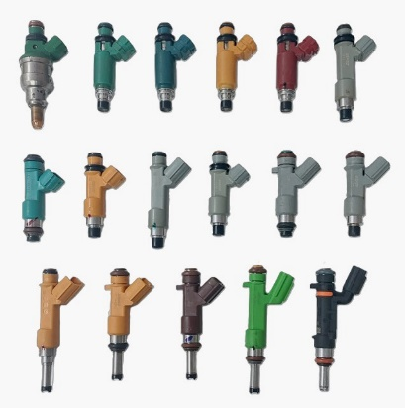
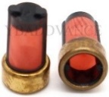
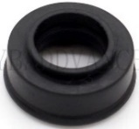

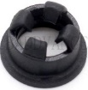
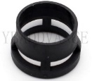
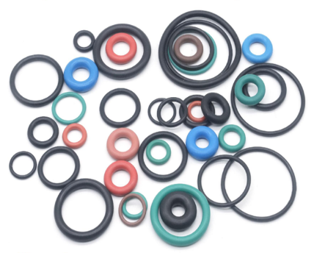
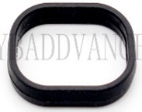
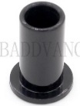
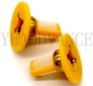
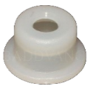
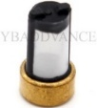
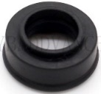

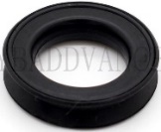
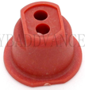
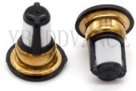
OUR PRODUCTS
REFURBISH INJECCTOR
INJECTOR FILTERS
INJECTOR O-RING
INJECTOR SEAL
INJECTOR PLASTIC PARTS

Slide 3

We Service All types of Petrol / Gasoline fuel Injectors
  . Solonoid Direct injector - GDI, ISI . Multi-Port Fuel Injector – MPFI
  . Central Port-Feed Injectors - CSFI, CPFI . Throttle Body Injector-TBI, CF2
  . Side Feed Injector – SF . Continuous Injection Injectors
  . K. Jetronic - MFI . Alternative Fuel Injectors - LPG, CNG
  . Racing Application Injectors . Motorcycle Application Injectors
Address
Contact No.:
Email ID
Facebook
Instagram
website
NOTE : Home page details. Search is on for better Product images

Slide 4

Our Service
- We at Regent Fuel Injectors specializes in diagnostic testing, cleaning and servicing of all types of
petrol and gasoline fuel injectors by experienced engineer and technicians./technical accuracy with a customer-focused approach.
- Using the state-of-the-art diagnostic test benches and ultrasonic cleaning equipment's we restore injectors to its best condition, hence improving engine efficiency and performance.
- Equipment's used at Regent Fuel Injectors for testing are approved by world-wide leading vehicle manufacturer and injector manufacturers such as BOSCH GmbH, Delphi and Magneti Marelli etc. allowing us to perform precise and efficient diagnostics on all types of fuel injectors.
The restorative procedure for fuel injectors utilizes a multi-stage process that includes precise flow testing and ultrasonic cavitation. This method is significantly more technical and more effective than simple solvent-based cleaning.

Slide 5

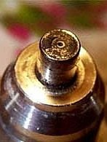
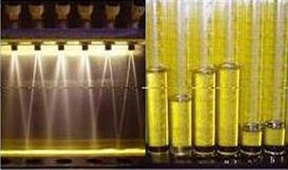
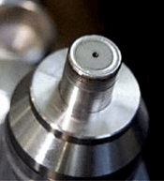
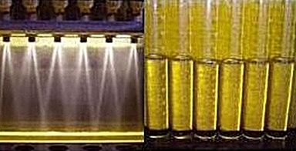
Our Service
At Regent Fuel Injector, every injector undergoes a precise, a thorough diagnostic and restoration process to meet OEM specifications. The procedure begins with pre-cleaning diagnostics to assess static and dynamic flow rate, spray pattern geometry, leak integrity, and electrical performance. This is followed by a intense three-stage ultrasonic cleaning process, enhanced by synchronized electronic pulsing to remove both internal and external deposits. After cleaning, each injector is re-tested on a calibrated test bench to verify flow balance, atomization quality, and pressure integrity. New filter baskets and seals are then installed to ensure proper sealing to prevent contamination. This comprehensive process guarantees that every injector performs consistently, efficiently, and reliably — restoring engines to their peak performance.
We are committed to give best results
Better Fuel Efficiency – Improve gas mileage and reduce fuel consumption.
Smoother Acceleration – Eliminate hesitation and engine misfires.
- Lower Emissions – Reduce harmful pollutants for a cleaner-running engine.
- Prevents Costly Repairs – Extend engine life and avoid expensive replacements.
Before Cleaning
After Cleaning

Slide 6
About Us – Regent Fuel Injectors
Regent Fuel Injectors has been a trusted name in the automotive industry since 2014, specializing in diagnostic testing, servicing, and cleaning of gasoline fuel injectors. We combine hands-on expertise with advanced technology to move beyond outdated trial-and-error methods—delivering faster, more accurate diagnostics and consistent results every time.
To be at par with the technology we continuously upgraded our equipment to stay ahead of evolving industry standards. Our systems are approved by global leaders such as BOSCH, Delphi, and Magneti Marelli, allowing us to perform precise and efficient testing on all types of fuel injectors.
Every service we provide is built on / At Regent our mission is to built value for our customer through collaboration, trust, and attention to detail. We take the time to understand each client’s needs and work closely to restore performance, improve efficiency, and extend the life of their engines.
We support automotive dealers, workshops, vehicle owners, fuel injector service centers, as well as marine and motorsport clients. Our comprehensive diagnostic and repair solutions target the root cause of injector issues—ensuring restored performance, improved fuel efficiency, and dependable operation.
As leaders in gasoline fuel injector servicing, we take pride in our technical expertise, transparent processes, and quick turnaround times. At Regent Fuel Injectors, every injector we service is renewed to meet original performance standards—with precision, reliability, and customer satisfaction at the core of everything we do.

Slide 7
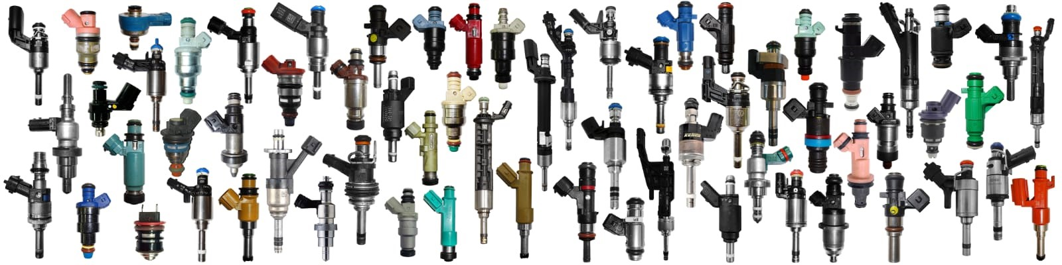

Slide 8
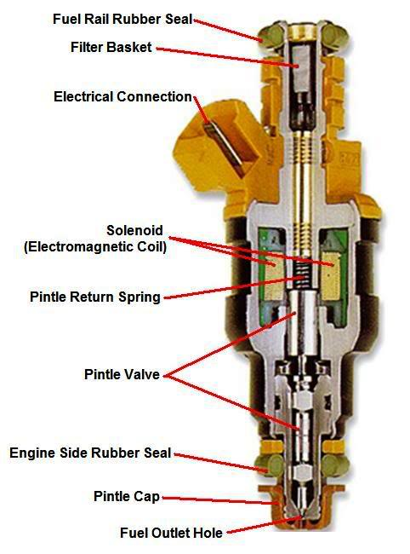
HOW FUEL INJECTOR WORKS
A fuel injector is an electronically controlled valve that both meters flow of fuel and atomizes fuel. The injector is located on the intake manifold of the engine, and is sealed between the manifold and the fuel supply rail.
Fuel injectors are normally fed power continuously when the ignition key is on. The computer controls the negative or ground side of the circuit. The (ECM or ECU or PCM) computer gathers information from various sensors and using this information, the computer determines the injector’s opening duration required for that combustion stroke. When the computer provides the injector with a ground (flips the switch on), the circuit is completed and current is allowed to flow through the injector’s electromagnetic coil.
Most injectors use a 10 to 20 micron internal final filter screen. A small 25% restriction in the injector filter will cause the ECM to increase the injector’s on-time by 25% to make up for the restricted filter and the loss of fuel flow!
The injector will remain open anywhere between 1 to 20 milliseconds depending on the engine’s needs (as determined by the ECM). The current stops when the computer removes the electric ground to the injector, the electromagnetic coil becomes de-energized and a small coil spring pushes the valve needle to the pintle seat and cuts off fuel flow.
Most dirty and clogged fuel injectors respond well to our ultrasonic fuel injector cleaning service and are restored to a “like new” clean condition and performance.

Slide 9
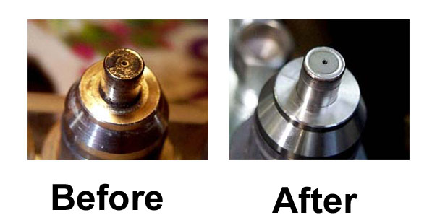
Why Injector needs cleaning
Dirty and clogged injectors can cause classic engine problems, lean misfire, rough idle, hesitation, loss of power, and higher emission levels of unburned fuel and carbon monoxide.
It doesn’t take much of a restriction in an injector to lean out the air / fuel mixture. A 10% restriction in the fuel flow of a single fuel injector can be enough to cause a lean misfire. When this occurs, unused oxygen enters the exhaust and makes the O2 sensor read lean (too little gas, too much O2). If the O2 sensor reads lean, then the computer will compensate by increasing the on time of the next injector(s) to fire, resulting in a now overly rich fuel condition. Now dirty hydrocarbon emissions (due to unburned fuel) and carbon monoxide emissions will rise in the cylinders that are now getting too much fuel. This is one cause of carbon and debris deposits on the injectors and the valves !!
The computer can only analyze the combined exhaust gases, and it averages out the air / fuel ratios. One or more clogged fuel injectors will cause some cylinders to run leaner, and the computer will then compensate and then cause other cylinders to run richer. This results in drivability and emissions issues.
Most customers experience a 10 to 15% improvement in gas mileage after getting their injectors cleaned and flow tested! Why pay for new fuel injectors when we can service them to “like new” for a fraction of the cost of new injectors?
Getting your injectors cleaned and flow tested saves you money and just makes good sense!

Slide 10
OUR TESTING & CLEANING PROCEDURE
1) Injectors are externally cleaned, visual inspected, and numbered.
2) Test injectors for resistance, shorts, and current draw.
3) Perform leak test, spray pattern, resistance while operating, and flow testing, (both pulsed and static), on one of our flow benches. Our different test machines are set up specifically for various types of injectors. The test results are recorded.
4) Remove filter baskets, o-rings, pintle caps, etc (where applicable).
5) The injectors are placed in our first ultrasonic cleaning tank to remove any particles, grease, etc from the exterior that may contaminate the next two cleaning processes.
6) Into the second temperature controlled ultrasonic tank they go, the injectors are now cycled on and off allowing the ultrasonic energy to dislodge any particles and build-up inside the injectors.
7) The injectors are now placed in our third ultrasonic tank for additional cleaning using a different cleaning solution. Once again they are being cycled on and off while being cleaned. This three tank, two cleaning solution cleaning process insures that any particles or contaminates are removed.
8) A high pressure back-flush is now done to remove any remaining particles inside.
9) Back to the flow bench for retesting of spray pattern, flow rate, coil resistance, and leak checking. If any injectors still are not flowing well, they will go back through the cleaning process and retested as many times as needed. This test data is also recorded.
10) Install new filter baskets, o-rings, seals, and pintle caps (where applicable)
11) Prepare a comprehensive test report with before and after test data. The injectors are then packed along with the old parts for return.

Slide 11
GASOLINE DIRECT INJECTOR (GDI)
Instead of delivering the fuel via an injector in the intake track before the intake valve, GDI or gasoline direct injected engines inject a very fine mist of fuel directly in to the combustion chamber hence the name Direct Injection. Direct injectors operate at fuel pressures that vary between 450 — 3000 Psi. To achieve these pressures, the gasoline is pressurized by a high pressure fuel pump that is mechanically driven and electronically controlled.
Manufacturers preferring their own abbreviation of the system, here are some of the ones currently in use:
FSI = VW Audi ( Fuel Stratified Injection)
SCi = Ford (Smart Charge Injection)
IDE = Renault (Injection Direct Essence)
JTS = Alfa Romeo (Jet Thrust Stoichiometric)
SIDI = Holden (Spark Ignition Direct Injection)
HPI = BMW (High Precision Injection)
HPDI = Porsche (High Pressure Direct Injection)
Ecotec = GM, Vauxhall, Opel
CGI = Mercedes Benz (Charged Gasoline Injection)
DISI = Ford/Mazda (Direct-Injection-Spark-Ignition)
GDI = Mitsubishi Peugeot Citroën, Hyundai, Volvo, (Gasoline Direct Injection)
Depending on the engine requirements, this style of injectors can have varying types of spray patterns. All direct injectors will atomizing a much smaller fuel droplet size than a normal MPI injector. Conventional injector would have a fuel droplet size of +/- 165 micron, where some GDI injectors would produce a fuel droplet of only +/- 65 micron. To maintain this kind of atomization it is important to include direct injection fuel injector cleaning in your maintenance schedule.
Fuel Distribution and Atomization is equally critical to the engine’s performance, fuel economy and emission outputs. A clogged direct injector or a set of dirty direct fuel injectors will cause a range of problems and in some instances even severe engine damage.
Our testing equipment allows us to critically examine direct injectors for correct electronic operation in response to changes in mS, RPM and proper atomization as well as the proper cleaning techniques that will allow us to restore your GDI injectors to original specification.
Most direct injection fuel injectors are difficult and time consuming to remove and re-fit; would you fit a set of injectors without ensuring they are working correctly?
Insist your dealer/mechanic/technician send your dirty clogged or leaking direct fuel injectors to us for cleaning before they attempt to replace them with expensive new ones. If the injector does not perform up to spec or we can not clean them, we will not charge you for the time spent on that injector. You will only be be responsible for return shipping.
Ultrasonic fuel injector cleaning service and flow testing will restore your dirty or clogged fuel injectors to the same level of a new fuel injector.

